Slide 1
Data Visualization
The commonality between science and art is in trying to see profoundly - to develop strategies of seeing and showing
Edward Tufte

Slide 2
Visualization skills
Humans are particularly skilled at processing visual information
An innate capability compared
Our ancestors were those who were efficient visual processors and quickly detected threats and used this information to make effective decisions

Slide 3
A graphical representation of Napoleon Bonaparte's invasion of and subsequent retreat from Russia during 1812. The graph shows the size of the army, its location and the direction of its movement. The temperature during the retreat is drawn at the bottom of figure, which was drawn by Charles Joseph Minard in 1861 and is generally considered to be one of the finest graphs ever produced.

Slide 4
Wilkinson’s grammar of graphics
Data
A set of data operations that create variables from datasets
Trans
Variable transformations
Scale
Scale transformations
Coord
A coordinate system
Element
Graph and its aesthetic attributes
Guide
One or more guides

Slide 5
ggvis
An implementation of the grammar of graphics in R
The grammar describes the structure of a graphic
A graphic is a mapping of data to a visual representation
ggvis
Notes:
http://had.co.nz/ggplot/

Slide 6
Data
Spreadsheet approach
Use an existing spreadsheet or create a new one
Export as CSV file
Database
Execute SQL query

Slide 7
Transformation
A transformation converts data into a format suitable for the intended visualization
# compute a new column in carbon containing the relative change in CO2
carbon$relCO2 = (carbon$CO2-280)/280

Slide 8
Coord
A coordinate system describes where things are located
Most graphs are plotted on a two-dimensional (2D) grid with x (horizontal) and y (vertical) coordinates
The default coordinate system for most graphic packages is Cartesian.

Slide 9
Element
An element is a graph and its aesthetic attributes
Build a graph by adding layers
library(ggvis)
url <- 'http://people.terry.uga.edu/rwatson/data/carbon.txt'
carbon <- read.table(url, header=T, sep=',')
# Select year(x) and CO2(y) to create a x-y point plot
# Specify red points, as you find that aesthetically pleasing
carbon %>% ggvis(~year,~CO2) %>% layer_points(fill:=‘red’)
# Notice how ‘%>%’ is used for creating a pipeline of commands

Slide 10
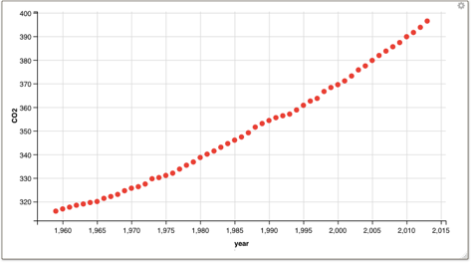
Element

Slide 11
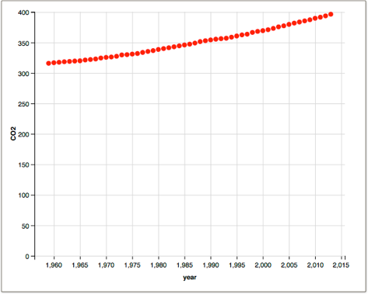
Scale
carbon %>% ggvis(~year,~CO2) %>% layer_points(fill:='red') %>%
scale_numeric('y',zero=T)

Slide 12
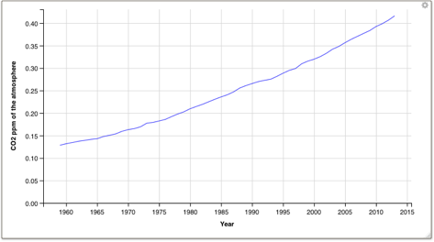
Axes
# Compute a new column containing the relative change in CO2
carbon$relCO2 = (carbon$CO2-280)/280
carbon %>% ggvis(~year,~relCO2) %>% layer_lines(stroke:='blue') %>%
scale_numeric('y',zero=T) %>%
add_axis('y', title = "CO2 ppm of the atmosphere", title_offset=50) %>%
add_axis('x', title ='Year', format = '####')

Slide 13
Guides
Axes and legends are both forms of guides
Helps the viewer to understand a graphic

Slide 14
Exercise
Create a line plot using the data in the following table.
Year | 1804 | 1927 | 1960 | 1974 | 1987 | 1999 | 2012 | 2027 | 2046
Population (billions) | 1 | 2 | 3 | 4 | 5 | 6 | 7 | 8 | 9

Slide 15
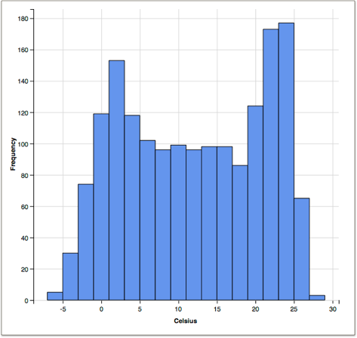
Histogram
library(ggvis)
url <- 'http://people.terry.uga.edu/rwatson/data/centralparktemps.txt'
t <- read.table(url, header=T, sep=',')
t$C <- round((t$temperature - 32)*5/9,1)
t %>% ggvis(~C) %>% layer_histograms(width = 2, fill:='cornflowerblue') %>%
add_axis('x',title='Celsius') %>%
add_axis('y',title='Frequency')

Slide 16
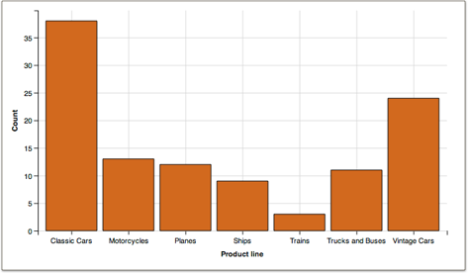
Bar graph
library(ggvis)
library(RMySQL)
conn <- dbConnect(RMySQL::MySQL(), "richardtwatson.com", dbname="ClassicModels", user="db1", password="student")
# Query the database and create file for use with R
d <- dbGetQuery(conn,"SELECT productLine from Products;")
# Plot the number of product lines by specifying the appropriate column name
d %>% ggvis(~productLine) %>% layer_bars(fill:='chocolate')
add_axis('x',title='Product line') %>%
add_axis(‘y’,title='Count')

Slide 17
Exercise
Create a bar graph using the data in the following table
Year | 1804 | 1927 | 1960 | 1974 | 1987 | 1999 | 2012 | 2027 | 2046
Population (billions) | 1 | 2 | 3 | 4 | 5 | 6 | 7 | 8 | 9

Slide 18
Scatterplot
library(ggvis)
library(RMySQL)
conn <- dbConnect(RMySQL::MySQL(), "richardtwatson.com", dbname="ClassicModels", user="db1", password="student")
# Get the monthly value of orders
d <- dbGetQuery(conn,"SELECT MONTH(orderDate) AS orderMonth, sum(quantityOrdered*priceEach) AS orderValue FROM Orders, OrderDetails WHERE Orders.orderNumber = OrderDetails.orderNumber GROUP BY orderMonth;")
# Plot data orders by month
# Show the points and the line
d %>% ggvis(~orderMonth, ~orderValue/1000000) %>%
layer_lines(stroke:='blue') %>%
layer_points(fill:='red') %>%
add_axis('x', title = 'Month') %>%
add_axis('y',title='Order value (millions)', title_offset=30)

Slide 19
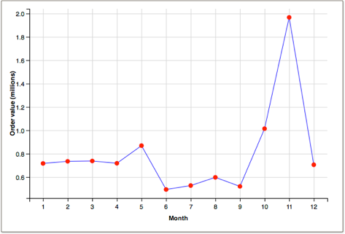
Scatterplot

Slide 20
Scatterplot
library(ggvis)
library(RMySQL)
conn <- dbConnect(RMySQL::MySQL(), "richardtwatson.com", dbname="ClassicModels", user="db1", password="student")
d <- dbGetQuery(conn,"SELECT YEAR(orderDate) AS orderYear, MONTH(orderDate) AS Month, sum((quantityOrdered*priceEach)) AS Value FROM Orders, OrderDetails WHERE Orders.orderNumber = OrderDetails.orderNumber GROUP BY orderYear, Month;")
# Plot data orders by month and display by year
# ggvis expects grouping variables to be a factor, so convert
d$Year <- as.factor(d$orderYear)
d %>% group_by(Year) %>% ggvis(~Month,~Value/1000, stroke = ~Year) %>%
layer_lines() %>%
add_axis('x', title = 'Month') %>%
add_axis('y',title='Order value (thousands)', title_offset=50)

Slide 21
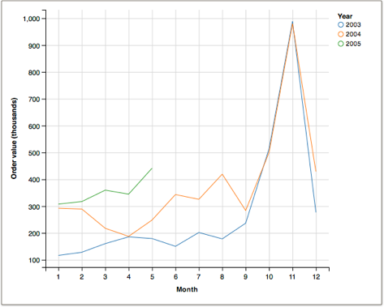
Scatterplot

Slide 22
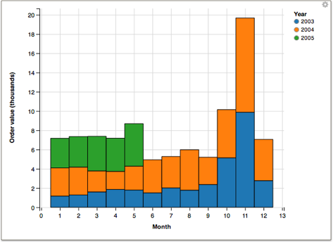
Bar graph
d %>% group_by(Year) %>% ggvis( ~Month, ~Value/100000, fill = ~Year) %>% layer_bars() %>%
add_axis('x', title = 'Month') %>%
add_axis('y',title='Order value (thousands)', title_offset=50)

Slide 23
Multiple files
library(ggvis)
library(sqldf)
library(RMySQL)
options(sqldf.driver = "SQLite") # to avoid conflict with RMySQl
# Load the driver
conn <- dbConnect(RMySQL::MySQL(), "richardtwatson.com", dbname="ClassicModels", user="db1", password="student")
orders <- dbGetQuery(conn,"SELECT 'Orders' as Category, MONTH(orderDate) AS month, sum((quantityOrdered*priceEach)) AS value FROM Orders, OrderDetails WHERE Orders.orderNumber = OrderDetails.orderNumber and YEAR(orderDate) = 2004 GROUP BY Month;")
payments <- dbGetQuery(conn,"SELECT 'Payments' as Category, MONTH(paymentDate) AS month, SUM(amount) AS value FROM Payments WHERE YEAR(paymentDate) = 2004 GROUP BY MONTH;")
# concatenate the two files
m <- sqldf("select month, Category, value from orders UNION select month, Category, value from payments")
m %>% group_by(Category) %>% ggvis(~month, ~value, stroke = ~ Category) %>%
layer_lines() %>%
add_axis('x',title='Month') %>%
add_axis('y',title='Value',title_offset=70)

Slide 24
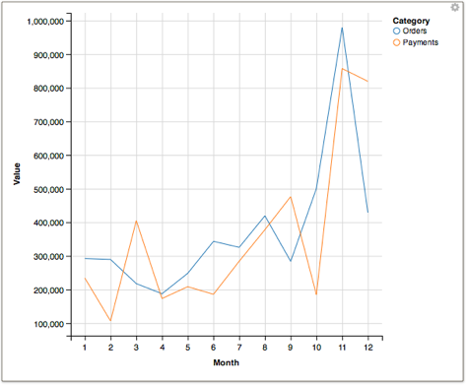
Multiple files

Slide 25
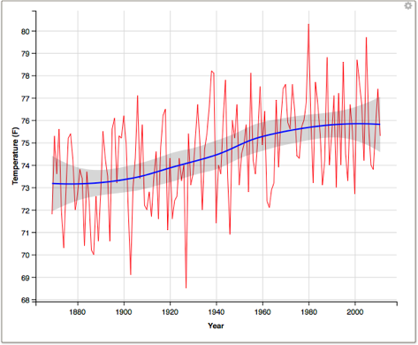
Smoothing
library(sqldf)
options(sqldf.driver = "SQLite") # to avoid conflict with RMySQl
url <- "http://people.terry.uga.edu/rwatson/data/centralparktemps.txt"
t <- read.table(url, header=T, sep=',')
t8 <- sqldf('select * from t where month = 8')
t8 %>% ggvis(~year,~temperature) %>%
layer_lines(stroke:='red') %>%
layer_smooths(se=T, stroke:='blue') %>%
add_axis('x',title='Year’,format = ’####') %>%
add_axis('y',title='Temperature (F)', title_offset=30)

Slide 26
Exercise
National GDP and fertility data have been extracted from a web site and saved as a CSV file
Compute the correlation between GDP and fertility
Do a scatterplot of GDP versus fertility with a smoother
Log transform both GDP and fertility and repeat the scatterplot with a smoother

Slide 27
Box plot
library(ggvis)
library(RMySQL)
options(sqldf.driver = "SQLite") # to avoid conflict with RMySQl
conn <- dbConnect(RMySQL::MySQL(), "richardtwatson.com", dbname="ClassicModels", user="db1", password="student")
d <- dbGetQuery(conn,"SELECT amount from Payments;")
# Boxplot of amounts paid
d %>% ggvis(~factor(0),~amount) %>% layer_boxplots() %>%
add_axis('x',title='Checks') %>%
add_axis('y',title='')

Slide 28
Box plot

Slide 29
Box plot
library(ggvis)
library(RMySQL)
options(sqldf.driver = "SQLite") # to avoid conflict with RMySQl
conn <- dbConnect(RMySQL::MySQL(), "richardtwatson.com", dbname="ClassicModels", user="db1", password="student")
d <- dbGetQuery(conn,"SELECT month(paymentDate) as month, amount from Payments;")
# Boxplot of amounts paid
d %>% ggvis(~factor(month),~amount) %>% layer_boxplots()

Slide 30
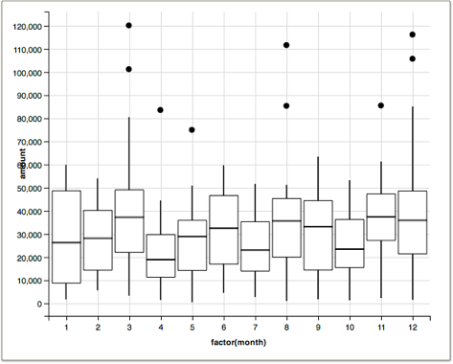
Box plot

Slide 31
Heatmap
library(ggvis)
library(RMySQL)
options(sqldf.driver = "SQLite") # to avoid conflict with RMySQL
# Load the driver
conn <- dbConnect(RMySQL::MySQL(), "richardtwatson.com", dbname="ClassicModels", user="db1", password="student")
d <- dbGetQuery(conn,'SELECT count(*) as Frequency, productLine as Line, productScale as Scale from Products group by productLine, productScale')
d %>% ggvis( ~Scale, ~Line, fill= ~Frequency) %>%
layer_rects(width = band(), height = band()) %>%
layer_text(text:=~Frequency, stroke:='white', align:='left', baseline:='top') # add frequency to each cell

Slide 32
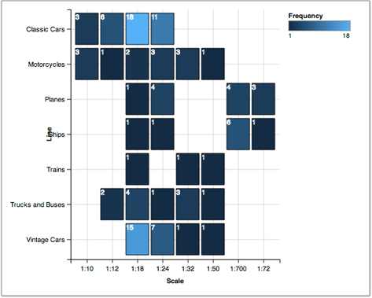
Heatmap

Slide 33
Interactive graphics
Function | Purpose
input_checkbox() | Check one or more boxes
input_checkboxgroup() | A group of checkboxes
input_numeric() | A spin box
input_radiobuttons() | Pick one from a set of options
input_select() | Select from a drop-down text box
input_slider() | Select using a slider
input_text() | Input text

Slide 34
Interactive graphics
Select a property from a drop-down list
carbon$relCO2 = (carbon$CO2-280)/280
carbon %>% ggvis(~year,~relCO2) %>%
layer_lines(stroke:=input_select(c("red", "green", "blue"))) %>%
scale_numeric('y',zero=T) %>%
add_axis('y', title = "CO2 ppm of the atmosphere", title_offset=50) %>%
add_axis('x', title ='Year', format='####')

Slide 35
Interactive graphics
Select a numeric value with a slider
carbon$relCO2 = (carbon$CO2-280)/280
slider <- input_slider(1, 5, label = "Width")
select_color <- input_select(label='Color',c("red", "green", "blue"))
carbon %>% ggvis(~year,~relCO2) %>%
layer_lines(stroke:=select_color, strokeWidth:=slider) %>%
scale_numeric('y',zero=T) %>%
add_axis('y', title = "CO2 ppm of the atmosphere", title_offset=50) %>%
add_axis('x', title ='Year', format='####')

Slide 36
dplyr
Designed to work with ggvis and %>%
Function | Purpose
filter() | Select rows
select() | Select columns
arrange() | Sort rows
mutate() | Add new columns
summarize() | Compute summary statistics

Slide 37
dplyr
library(sqldf)
library(dplyr)
options(sqldf.driver = "SQLite") # to avoid conflict with RMySQL
url <- 'http://people.terry.uga.edu/rwatson/data/centralparktemps.txt'
t <- read.table(url, header=T, sep=',')
# filter
sqldf("select * from t where year = 1999")
filter(t,year==1999)
# select
sqldf("select temperature from t")
select(t,temperature)
# a combination of filter and select
sqldf("select * from t where year > 1989 and year < 2000")
select(t,year, month, temperature) %>% filter(year > 1989 & year < 2000)
# arrange
sqldf("select * from t order by year desc, month")
arrange(t, desc(year),month)
# mutate -- create a new column
t_SQL <- sqldf("select year, month, temperature, (temperature-32)*5/9 as CTemp from t")
t_dplyr <- mutate(t,CTemp = (temperature-32)*5/9)
# summarize
sqldf("select avg(temperature) from t")
summarize(t,mean(temperature))

Slide 38
dplyr & ggvis
library(ggvis)
library(dplyr)
url <- 'http://people.terry.uga.edu/rwatson/data/centralparktemps.txt'
t <- read.table(url, header=T, sep=',')
slider <- input_slider(1, 12,label="Month")
t %>%
ggvis(~year,~temperature) %>%
filter(month == eval(slider)) %>%
layer_points() %>%
add_axis('y', title = "Temperature", title_offset=50) %>%
add_axis('x', title ='Year', format='####')

Slide 39
Geographic data
ggmap supports multiple mapping systems, including Google maps
library(ggplot)
library(ggmap)
library(mapproj)
library(RMySQL)
options(sqldf.driver = "SQLite") # to avoid conflict with RMySQl
# connect to the database
conn <- dbConnect(RMySQL::MySQL(), "richardtwatson.com", dbname="ClassicModels", user="db1", password="student")
# Google maps requires lon and lat, in that order, to create markers
d <- dbGetQuery(conn,"SELECT y(officeLocation) AS lon, x(officeLocation) AS lat FROM Offices;")
# show offices in the United States
# vary zoom to change the size of the map
map <- get_googlemap('united states',marker=d,zoom=4)
ggmap(map) + labs(x = 'Longitude', y = 'Latitude') + ggtitle('US offices')

Slide 40
Map

Slide 41
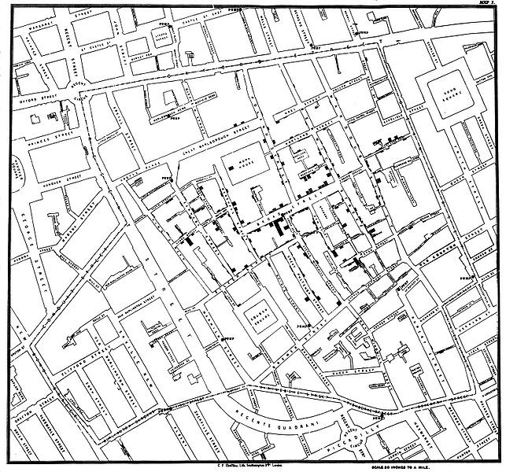
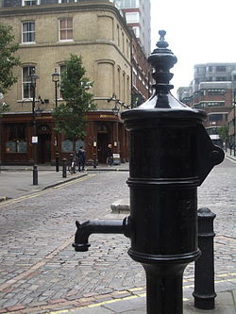
John Snow 1854 Broad Street cholera map
Water pump
Notes:
http://en.wikipedia.org/wiki/File:Snow-cholera-map-1.jpg
http://en.wikipedia.org/wiki/File:John_Snow_memorial_and_pub.jpg

Slide 42
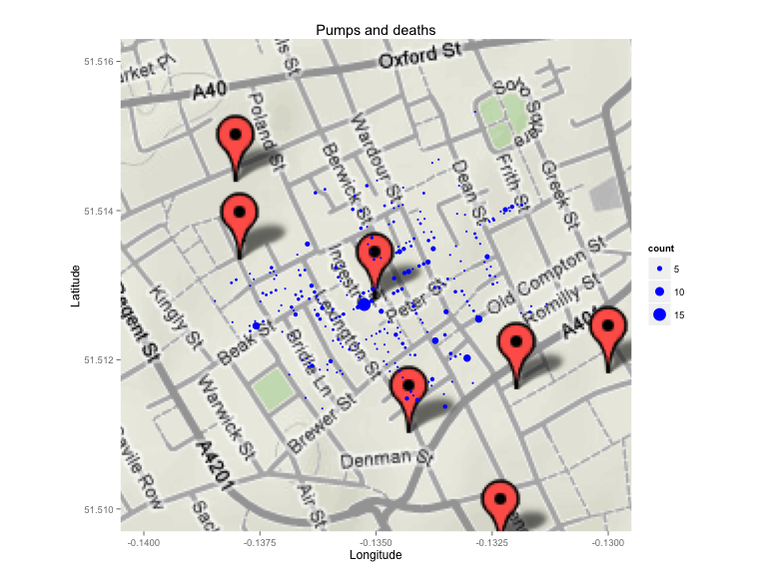
Cholera map (now Broadwick Street)
library(ggplot2)
library(ggmap)
library(mapproj)
url <- 'http://people.terry.uga.edu/rwatson/data/pumps.csv'
pumps <- read.table(url, header=T, sep=',')
url <- 'http://people.terry.uga.edu/rwatson/data/deaths.csv'
deaths <- read.table(url, header=T, sep=',')
map <- get_googlemap('broadwick street, london, united kingdom',markers=pumps,zoom=15)
ggmap(map) + labs(x = 'Longitude', y = 'Latitude') + ggtitle('Pumps and deaths') +
geom_point(aes(x=longitude,y=latitude,size=count),color='blue',data=deaths) +
xlim(-.14,-.13) + ylim(51.51,51.516)

Slide 43
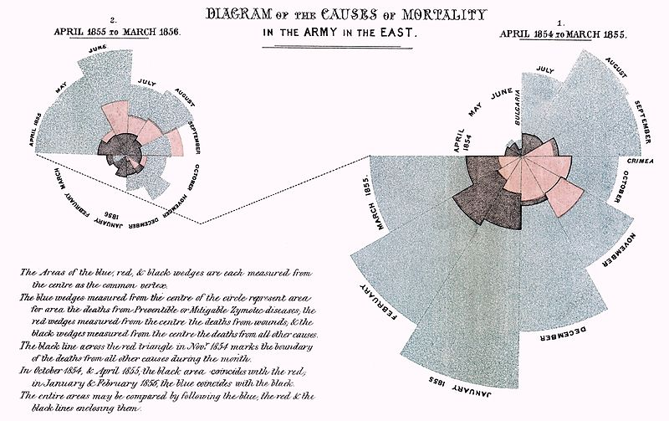
Florence Nightingale
Notes:
http://en.wikipedia.org/wiki/File:Nightingale-mortality.jpg

Slide 44
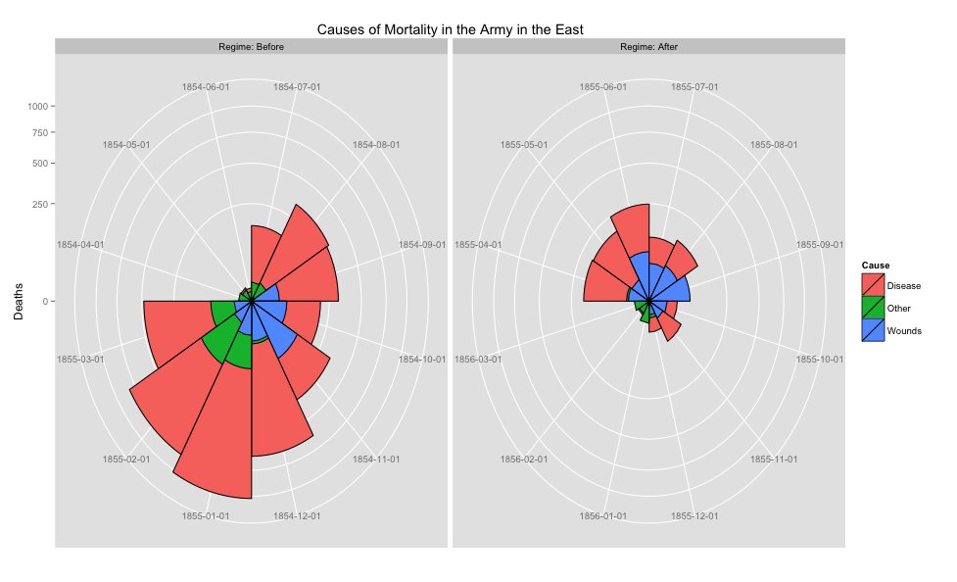
Florence Nightingale (code)

Slide 45
Key points
ggvis is based on a grammar of graphics
Very powerful and logical
Supports interactive graphics
You can visualize the results of SQL queries using R
The combination of MySQL and R provides a strong platform for data reporting

